Slide 1
FUN WITH CSS
Made by:
YAs Ansari,
Nédis Barreto,
Laurian staicu
Elmira Amanollahi

Slide 2
Training
We chose a YouTube video
Build a 5 element carousel

Slide 3
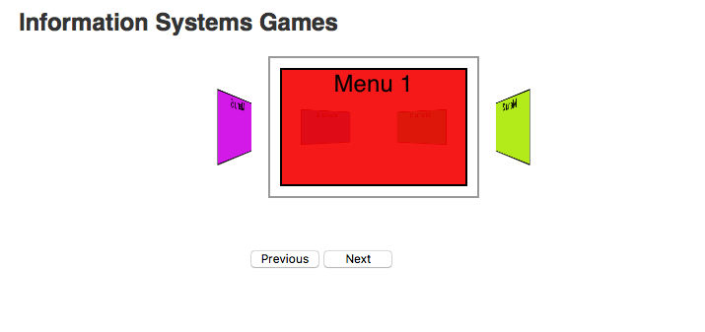
5 element training carousel

Slide 4
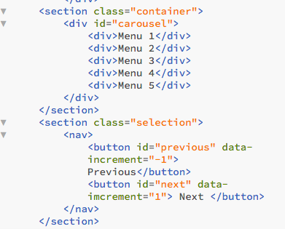

Slide 5
Carousel IN CSS
RADIO BUTTONS
HTML:
<input id="three" name="carousel" type="radio" value="3"><label for="three">3</label>
CSS ROTATION AND 3D MOVEMENT STYLE:
input[value="3"]:checked ~ .container .carousel { -webkit-transform: translateZ(-540px) rotateY(-90deg);}

Slide 6
Carousel IN CSS
SCREENS
.carousel li:nth-child(1) ul {
background-image: url(../images/1.jpg);
-webkit-transform: translateZ(540px) scale(.8);
}
.carousel li:nth-child(2) ul {
background-image: url(../images/2.jpg); -webkit- transform: rotateY(45deg) translateZ(540px) scale(.8);
}
…

Slide 7
Using frame work carousel
The CSS quiz game
Based from the book example
We adapted the app to our requirements
Very good understanding of the code structure

Slide 8
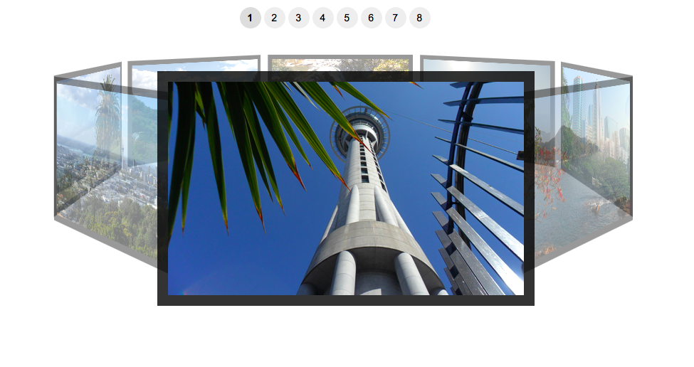
Original book application

Slide 9
Brainstorming and planning of the game
Quick meeting and planning of goals
Stating research
Gathering information for technical solutions
Assignment of tasks

Slide 10
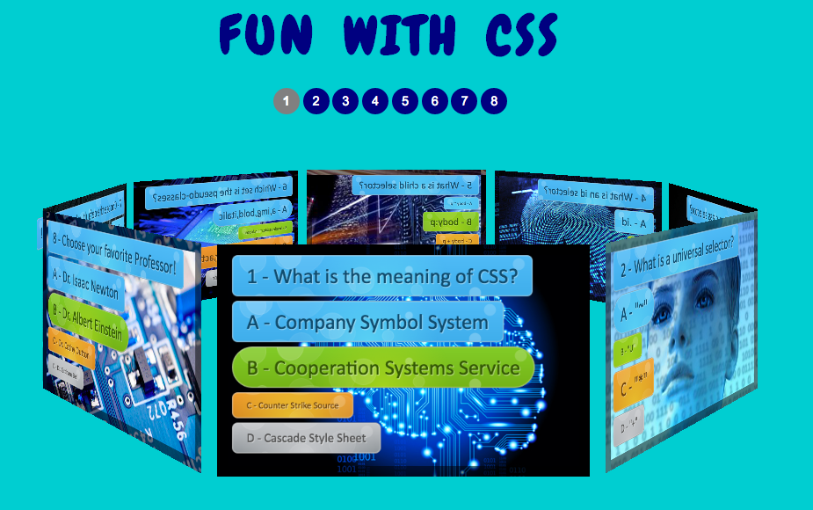
Final version of project

Slide 11
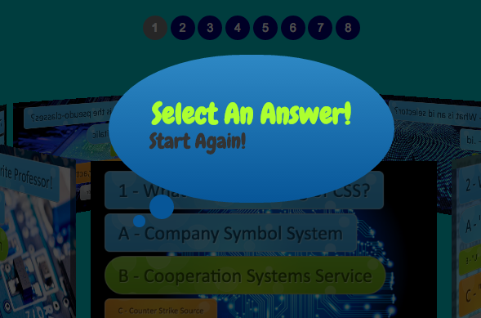
Using pure css to implement bubbles

Slide 12
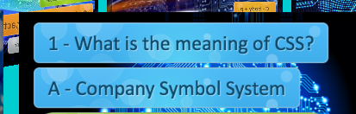
Using css library to implement fancy buttons

Slide 13
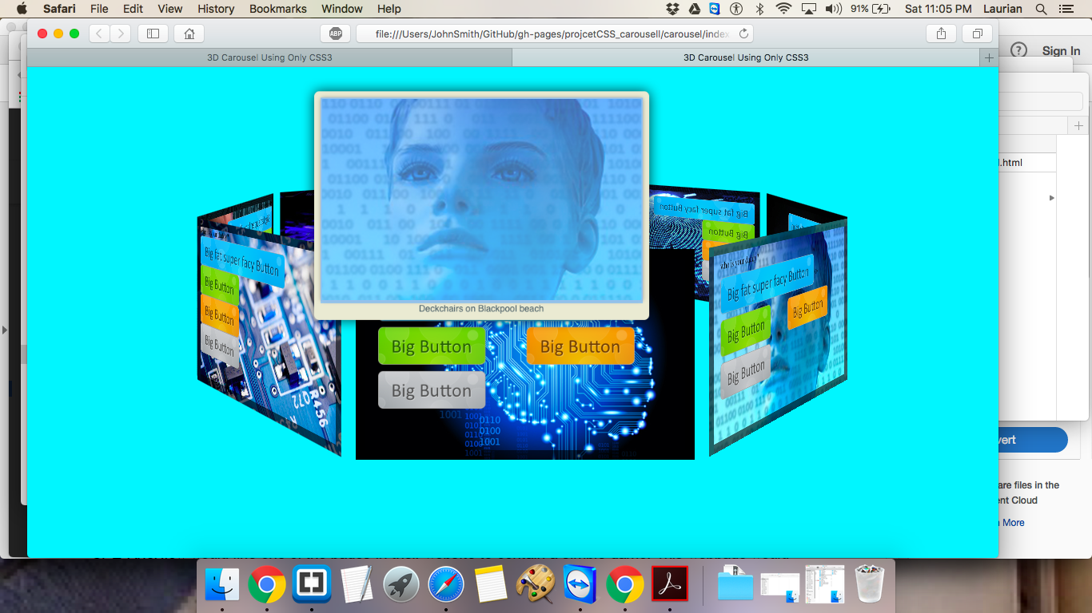
Technical problem encountered

Slide 14
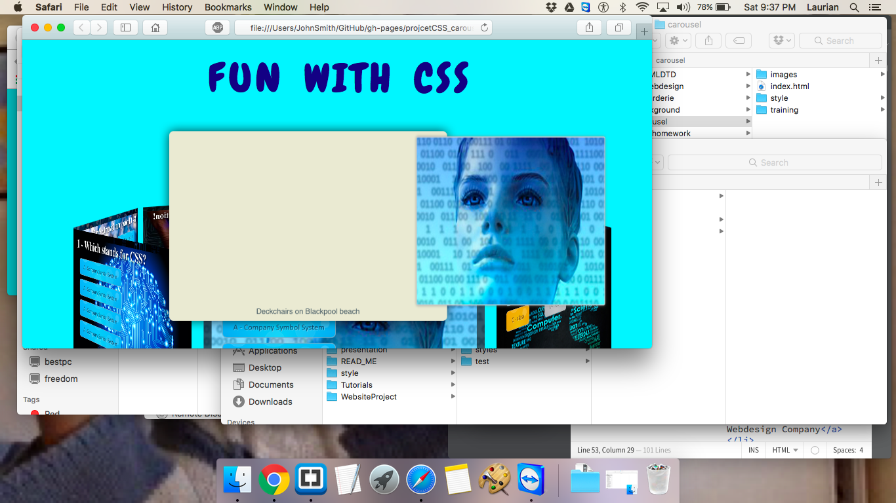
issues Rotating the octagon

Slide 15
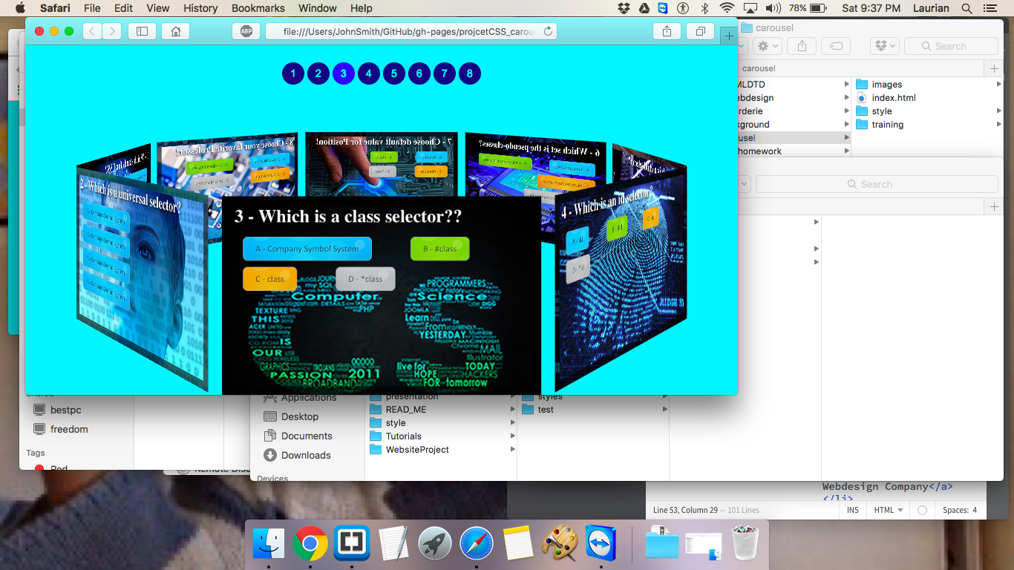
No pop out picture on the opposite side

Slide 16

Thank you for watching

